Slide 1
Practical Mineralogy G102

Slide 2
Outlines
Physical properties of minerals
Colour
Streak
Luster
Luminescence
Transparency
Cleavage
Hardness
Fracture
Tenacity

Slide 3
Physical properties
Colour
It is produced as a result of absorption of certain wavelengths and reflection of others.
Dark-coloured minerals means that the mineral absorbed all wavelengths of light.
Green-coloured minerals mean that these minerals absorbed all wavelengths of the light and reflect the green light only.

Slide 4
Physical properties
Idiochromatic minerals: Those minerals which have a constant and characteristic colour such as sulphur is yellow and azurite is blue.

Slide 5
Physical properties
Allochromatic minerals: those minerals whose colour are variable due to some impurities.
Pure quartz is colourless
Amethyst is violet or purple due to presence of iron (Fe) Rose quartz is pink due to some inclusions of boron (B).
ⓒ en.es-static.us
ⓒ healingwithhypnotherapy.com

Slide 6
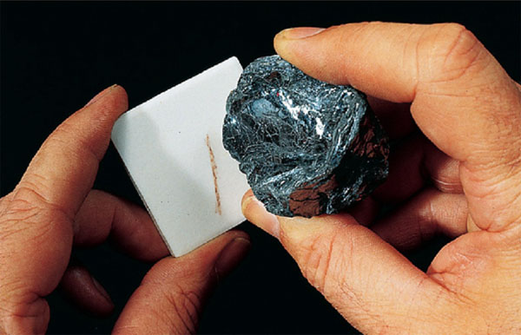
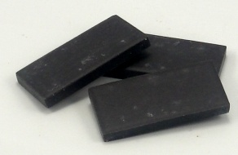
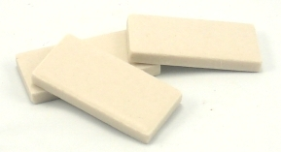
2. Streak
It is the colour of the powder of the mineral. It can be obtained by crushing or scratching the mineral on a piece of white porcelain (streak plate).
Black streak plate
White streak Plate

Slide 7
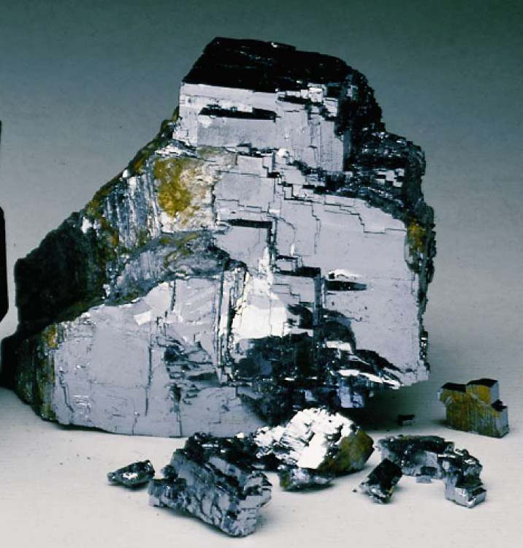
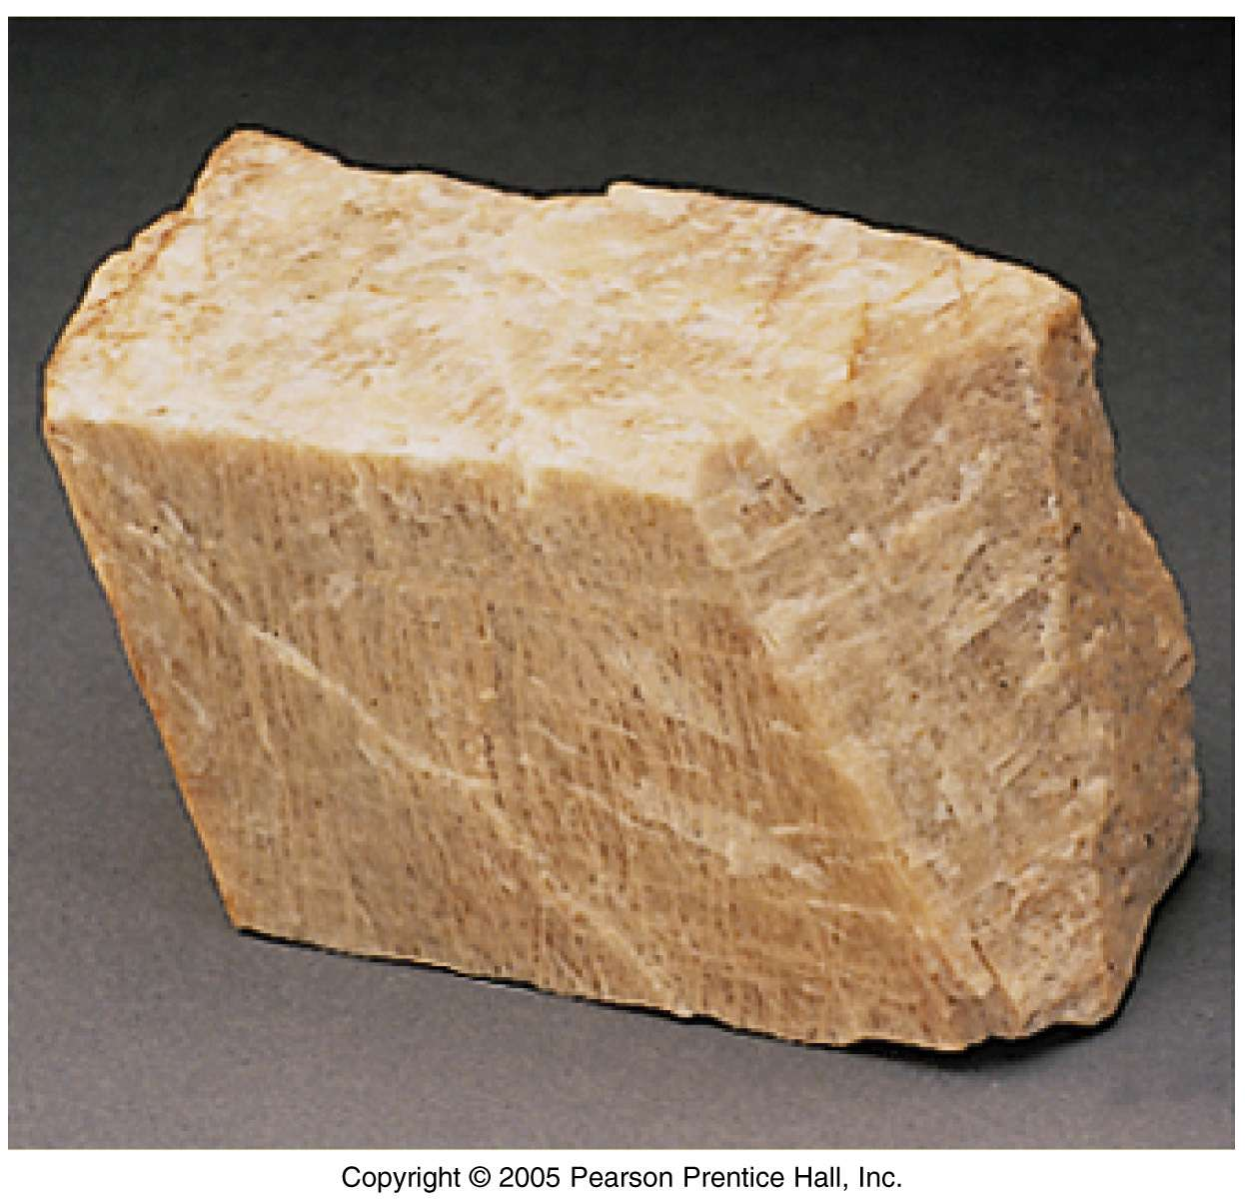
3. Luster
The light reflection from the surface of minerals.
Two major types:
Metallic luster: opaque minerals including native and sulphides
Submetallic luster: Semi-opaque to opaque minerals such as cuprite and hematite.
Non-metallic luster: it has several types
Metallic
Galena
Non-metallic
Orthoclase

Slide 8
3. Luster
Non-metallic lustre: it has several types:
Vitreous - looks glassy. Generally, silicates, carbonates, phosphate…etc. examples: clear quartz, tourmaline
Resinous - looks resinous - examples: sphalerite, sulphur.
Pearly - pearl-like luster - example: talc.
Greasy - appears to be covered with a thin layer of oil.
Silky - looks fibrous. - examples - some gypsum and serpentine.
Adamantine - brilliant lustre like diamond.
Earthy – dull surface that lacks any shines - such as kaolinite.

Slide 10
Physical properties
Luminescence
It is defined as emission of light and it is produced by irradiating sample with ultraviolet light.
The phenomenon of luminescence is linked to the crystal structure where some minerals have defected internal lattices.
Red
Green
Alexandrite

Slide 11
Physical properties
Transparency
The ability of light to transfer through a mineral. Mineral can be classified into:
Transparent: when the light enters and exits the surface of the substance in relatively undisturbed style, such as pure quartz and pure gypsum.
Translucent: when the light can enter and exit the surface of the substance, but in a disturbed and distorted way, such as smoky quartz.
Opaque: when the light cannot even penetrate the surface of the substance, such as galena.

Slide 12
Physical properties
Transparency
Many substances that are transparent can easily contain impurities and/or distortions that will limit a light beam's travels through a substance and make it translucent. Also, some translucent mineral specimens can become opaque as a result of inclusions or weathering effects.

Slide 13
Physical properties
Cleavage
Cleavage is the breakage of a mineral along regular planes and always parallel to certain crystal faces .
Cleavage can be described as:
Perfect if the planes are continuous.
Imperfect if the planes are discontinuous.

Slide 14
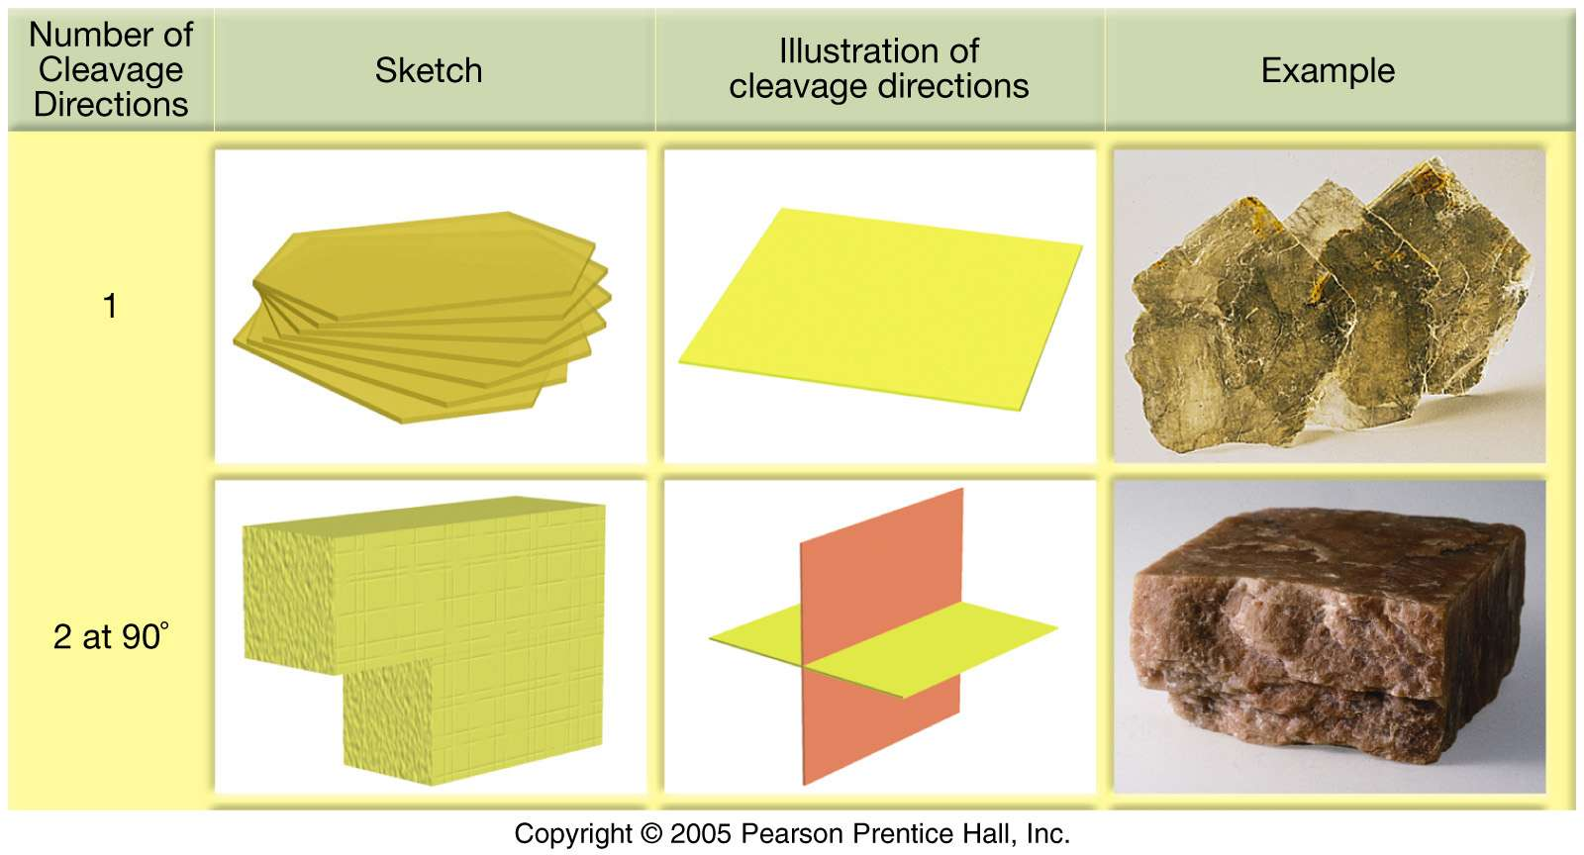
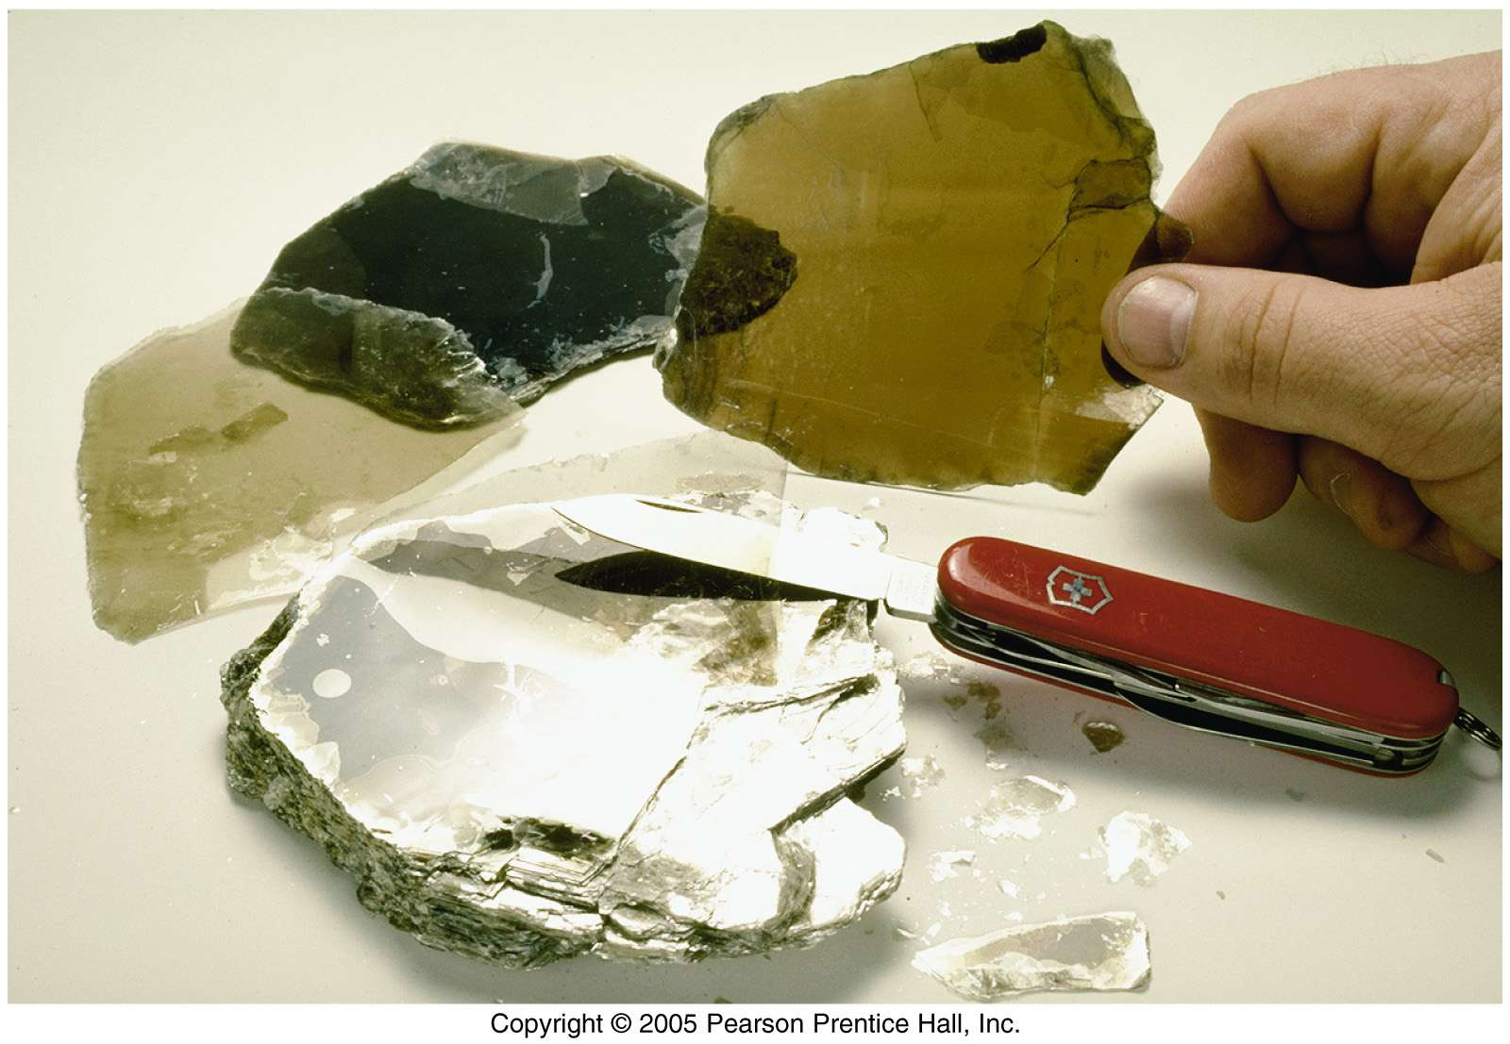
One set of planes
Example: mica

Slide 15
Two sets of planes
orthoclase
Three sets of planes
calcite

Slide 16
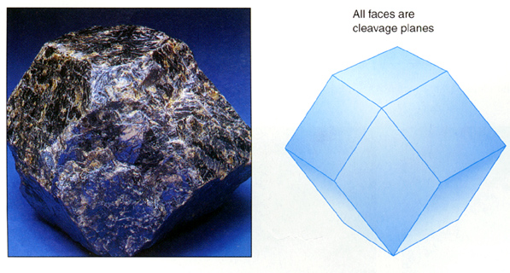
Four sets of planes
fluorite
Six sets of cleavage such as sphalerite

Slide 17
Physical properties
Hardness
Mineral is defined as the resistance to scratching and breakage, and it is very diagnostic feature in minerals identification.
Moho’s scale of hardness
It is developed by Frederich Mohs (1822).
It consists of 10 minerals, ranked 1 (softest) to 10 (hardest)

Slide 18
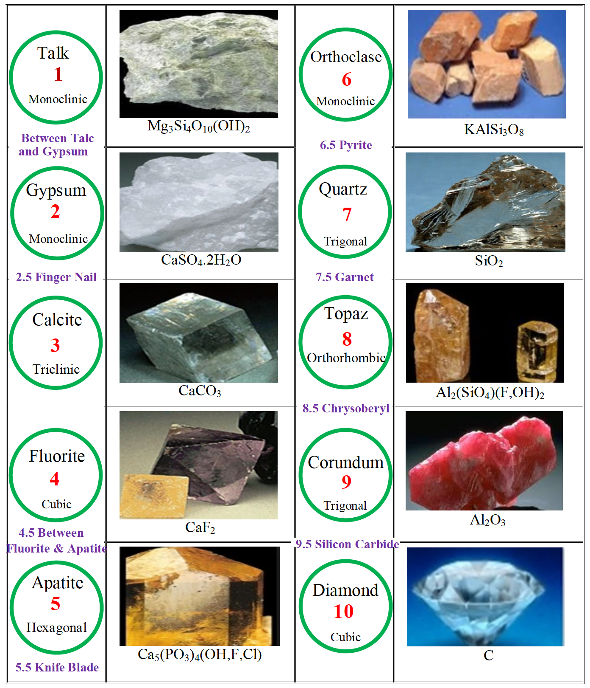
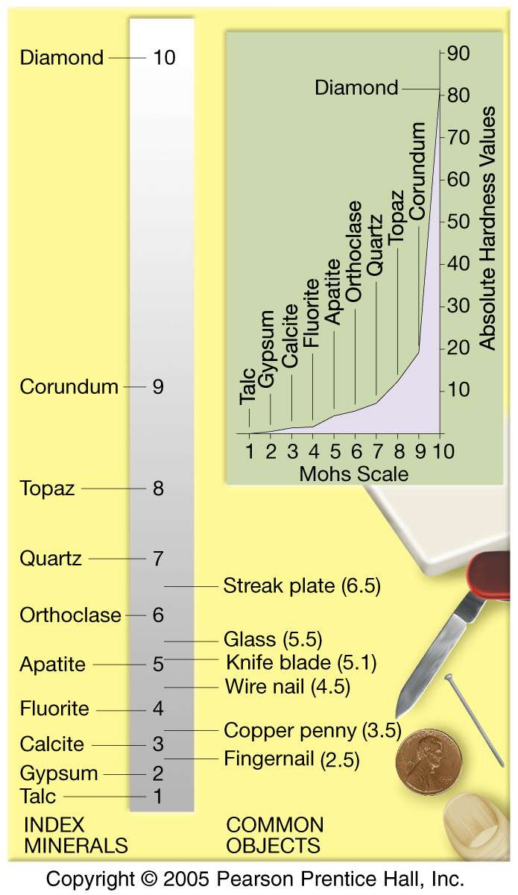

Slide 19
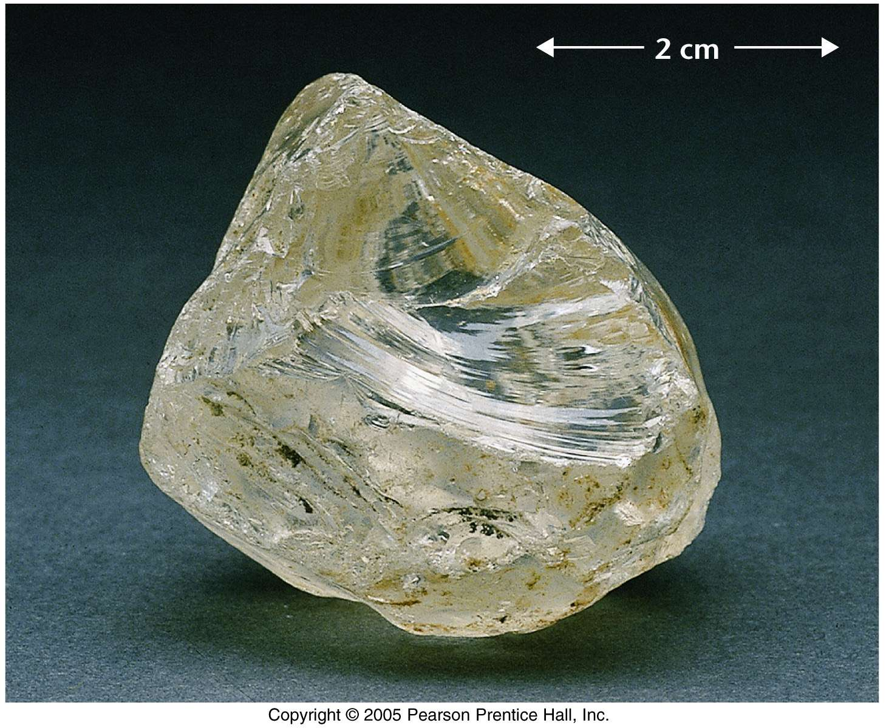
Physical properties
7. Fracture
It is irregular breakage.
Quartz

Slide 20
Physical properties
Several different kinds of fracture patterns are observed.
Conchoidal: It is a smoothly curving fracture surface which have no planar surfaces of internal weakness or planes of separation - no cleavage.

Slide 21
Physical properties
Subconcoidal: this is similar to conchoidal fracture, just not as curved, but still smooth such as galena and andalusite minerals.

Slide 22
Physical properties
Fibrous or splintery: similar to the way wood breaks. It occurs in finely acicular minerals and in minerals that have a relatively stronger structure in one direction than the other two directions such as serpentine and gypsum.

Slide 23
Physical properties
Jagged or hackly: has sharp edges that catch on a finger that is rubbed jagged fractures with sharp edges, such as copper mineral.

Slide 24
Physical properties
Earthy: It is found in minerals that are massive and loosely consolidated such as kaolinite and limonite.

Slide 25
Physical properties
Uneven or Irregular: rough irregular surfaces such as anhydrite and pyrite.

Slide 26
Physical properties
8. Tenacity
It is the resistance of a mineral to breaking, crushing, or bending. Tenacity can be described by the following terms.
1. Brittle - Breaks or powders easily.
2. Malleable - can be hammered into thin sheets – such as gold and silver.
3. Ductile: can be drawn into a wire. Malleable materials may also be ductile

Slide 27
Physical properties
4. Sectile - can be cut into thin shavings with a knife – such as gypsum.
5. Flexible - bends somewhat and does not return to its original shape.
6. Elastic - bends but does return to its original shape – such as mica.

